Slide 1
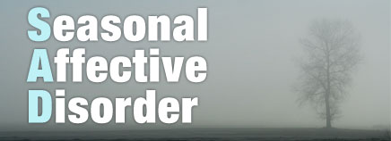
How weather affects people
By: Emina Mehmedovic met 1010

Slide 2
What happens to a persons mood?
When the weather changes and it rains; people tend to be more aggressive.
As temperature rises human aggression also rises.
When there is more sunlight people tend to be in a happier mood vs. when the day is gloomy.

Slide 3
What is Seasonal Affective Disorder (SAD)?
Seasonal affective disorder is a type of depression which begins in fall and through winter.
SAD has symptoms like: feeling depression nearly everyday, low energy, weight gain, lost of interest, difficulty with remembering details and making decisions, changes in weight, thoughts of suicide and death.
SAD usually goes away when spring and summer rolls around.
Women suffer from SAD up to 3X more than men.

Slide 4
Risk factors of SAD:
Being female.
People of young age have a higher risk of winter SAD.
Living far away from the equator.
Less sunlight.
Longer days.

Slide 5
What are the possible causes of SAD?
There have been many studies proving that SAD happens when there is a decrease in sunlight. The decrease in sunlight disturbs the body’s internal clock and leads to feelings of depression.
A drop in serotonin(brain chemical) that affects the mood.
Season change disturbs the balance of melatonin levels in the body; Which causes change in sleep patterns.
The Lower levels of vitamin D is responsible for a negative affect and tiredness.

Slide 6
SAD during fall/winter:
There is less sunlight and the days are shorter which leads to depression in some people.
People tend to get Seasonal affective disorder or (SAD).
SAD is a type of depression that’s related to the change in seasons.
Depression begins in the fall and goes throughout the winter months.
Oversleeping
Social withdrawal
Craving foods in high carbohydrates

Slide 7
During Summer :
It is proven by many psychologists that sunny weather make people more happier.
Researchers also believe that with new environments that are provided when people take trips and vacations during warm weather comes an atmosphere which creates a wonderful aura and provide relaxation time.
Warm, pleasant, and fair weather makes people smile and want to go outside and have fun.
Insomnia
Anxiety

Slide 8
Treatments for SAD:
Light therapy- consists of regular, daily exposure to a “light box,” which artificially simulates high-intensity sunlight. Practically, this means that a person will spend approximately 30 minutes sitting in front of this device shortly after they awaken in the morning. Treatment usually continues from the time of year that a person’s symptoms begin, such as in fall, on a daily basis throughout the winter months.
Cognitive behavioral therapy- is a form of treatment that focuses on examining the relationships between thoughts, feelings and behaviors.
Exercise

Slide 9
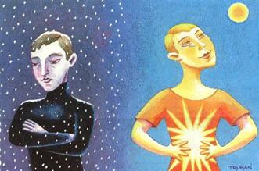
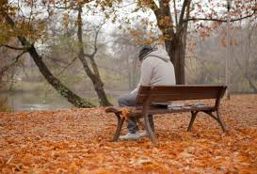
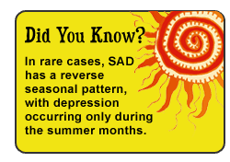
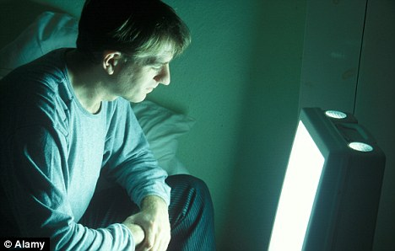
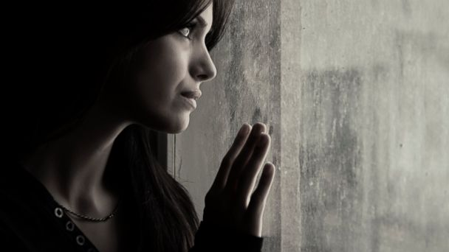
What SAD looks like:

Slide 10
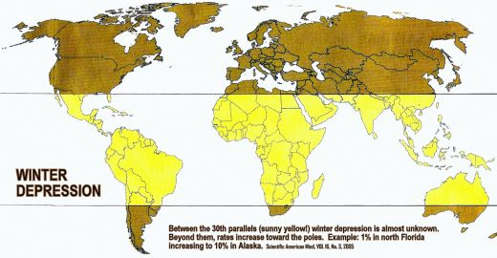
Chart of where SAD hits the most:
The sunny yellow is used to show that SAD doesn’t even existed there. The dark yellow is used to show those are the places where winter depression hits the most. It increases to 10% in Alaska. (2005)

Slide 11
A Seasonal Affective Disorder Documentary in Britain
https://www.youtube.com/watch?v=tbQaayDj9eI

Slide 12
Conclusion:
In conclusion, weather can affect people’s moods depending on where they live, how much sunlight there is, and what the weather is like everyday. Also, our internal clocks get disoriented and this psychologically affects our emotions.

Slide 13
Work cited:
M. Grohol, John. "Psych Central - Treatment for Seasonal Affective Disorder (SAD)." <i>Psych Central - Treatment for Seasonal Affective Disorder (SAD)</i>. Web. 19 Nov. 2014. &lt;http://psychcentral.com/library/seasonal_affective_treatment.htm&gt;.
"NIH News in Health." <i>NIH News in Health RSS</i>. Web. 24 Nov. 2014. &lt;http://newsinhealth.nih.gov/issue/Jan2013/Feature1&gt;.
"Seasonal Affective Disorder (SAD)." <i>Definition</i>. Web. 25 Nov. 2014. &lt;http://www.mayoclinic.org/diseases-conditions/seasonal-affective-disorder/basics/definition/con-20021047&gt;.
"Seasonal Affective Disorder." <i>Home</i>. Web. 26 Nov. 2014. &lt;http://www.psychiatry.org/seasonal-affective-disorder&gt;.

